Slide 1
Movie Recommendation System: A Comparative Analysis Of Machine Learning And Deep Learning Models
Presented by : Prashant Neupane Supervisor : Anu Baba
Date : 27 November, 2024

Slide 2
Introduction
Recommender System helps users find relevant contents
Widely Used in Platforms like Netflix, Amazon and youtube
Traditional Methods Struggle with Scalability and Accuracy
Essential for improving User Experience And Business Performance

Slide 3
Purpose
To develop advanced movie recommendation algorithms using ML and DL method
To Evaluate and compare model performance using MSE, RMSE, and MAE
Assess top recommendation systems to identify challenges and propose solutions

Slide 4
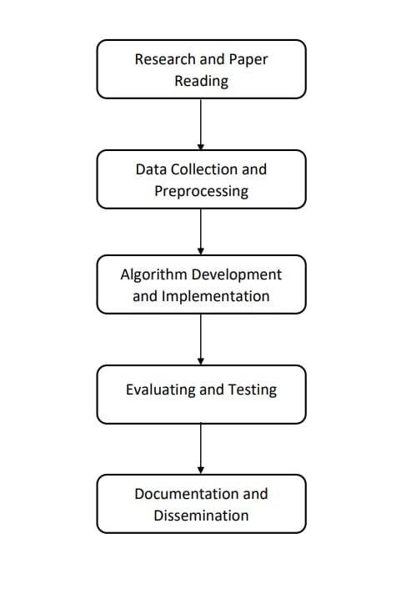
Methodology
Data Used
Algorithms Used : KNN With Means, Support Vector Machine (SVM), Neural Collaborative Filtering (NCF), Transformer
Development Environment : Google Colab, Jupyter Notebook
Programming Language : Python
Libraries : Numpy, Pandas, Matplotlib, Scikit-Learn, Tensorflow, Keras
MovieLens Dataset With 100,836 Ratings For 9742 Movies
610 Users With at least 20 ratings each
Data Files : Movies.csv, ratings.csv, links.csv, tags.csv
Key Features : movieid, title, genres, ratings, tag, timestamp

Slide 5
Result And Analysis
KNN With Means: Fastest (0.56s), lower accuracy (MSE: 0.822).
SVD: Best accuracy (MSE: 0.753), moderate training time (1.07s).
Neural Collaborative Filtering: Good accuracy (MSE: 0.838), high training time (35.99s).
Transformer Model: High accuracy (MSE: 0.835), longest training time (92.82s).
S.N | Model | MSE | RMSE | MAE | Training Time (Seconds)
1 | KNN With Means(ML) | 0.822 | 0.907 | 0.695 | 0.56
2 | SVD(ML) | 0.753 | 0.868 | 0.666 | 1.07
3 | Neural Collaborative Filtering(DL) | 0.838 | 0.915 | 0.694 | 35.99
4 | Transformer Model (DL) | 0.835 | 0.913 | 0.686 | 92.82

Slide 6
Conclusion
SVD performed best in accuracy with the lowest MSE and RMSE.
KNN With Means offered the fastest training time, though with lower accuracy.
Deep learning models (NCF & Transformer) provided high accuracy but needed more computational power and time.

Slide 7
Future Work
Combine ML (KNN, SVD) and DL (Transformer, Neural Collaborative Filtering) models for better performance.
Optimize deep learning models using pruning, quantization, and distributed computing.
Add real-time feedback to adjust recommendations based on user preferences.
Use cloud computing for scalability and handling larger datasets.

Slide 8
References
He, X., Liao, L., Zhang, H., et al. (2017). Neural Collaborative Filtering. Proceedings of the 26th International Conference on World Wide Web (WWW), 173-182.
Koren, Y., Bell, R., & Volinsky, C. (2009). Matrix Factorization Techniques for Recommender Systems. Computer, IEEE Computer Society, 42(8), 30-37.
Vaswani, A., Shazeer, N., Parmar, N., et al. (2017). Attention Is All You Need. Advances in Neural Information Processing Systems (NeurIPS).
Harper, F. M., & Konstan, J. A. (2015). The MovieLens Datasets: History and Context. ACM Transactions on Interactive Intelligent Systems (TiiS), 5(4).
Ricci, F., Rokach, L., Shapira, B. (2015). Recommender Systems Handbook. Springer.

Slide 9
Demo

Slide 10
Thank You !!

